Slide 1
Minimum Spanning Tree

Slide 2
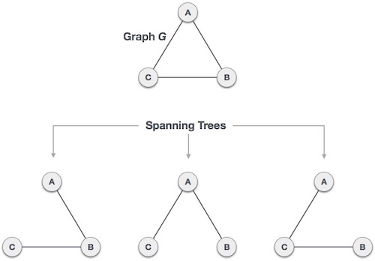
Tree and Spanning Tree
Tree: A connected acyclic graph
Given a connected and undirected graph, a spanning tree of that graph is a subgraph that is a tree and connects all the vertices together.

Slide 3
Minimum Spanning Tree
A minimum spanning tree (MST) or minimum weight spanning tree for a weighted, connected, undirected graph is a spanning tree with a weight less than or equal to the weight of every other spanning tree.

Slide 4
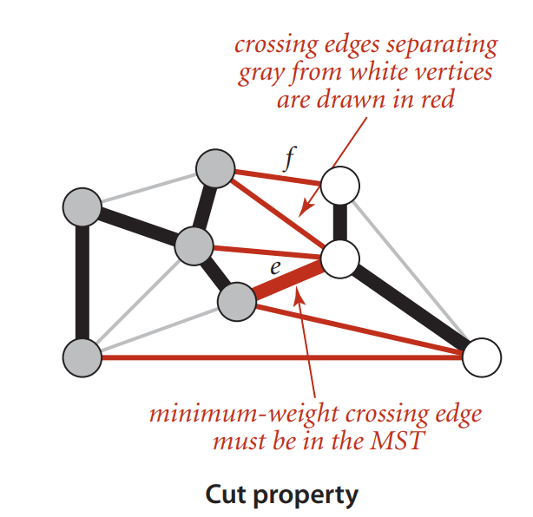
Prims Algorithm (Idea)

Slide 5
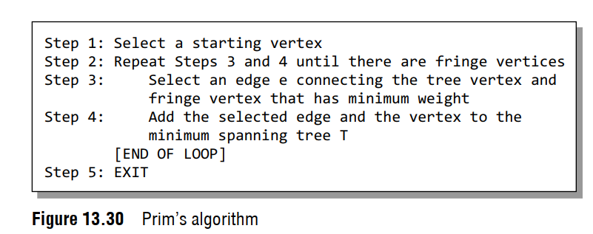
Prims Algorithm

Slide 6
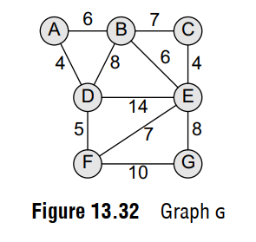
Prims Algorithm

Slide 7
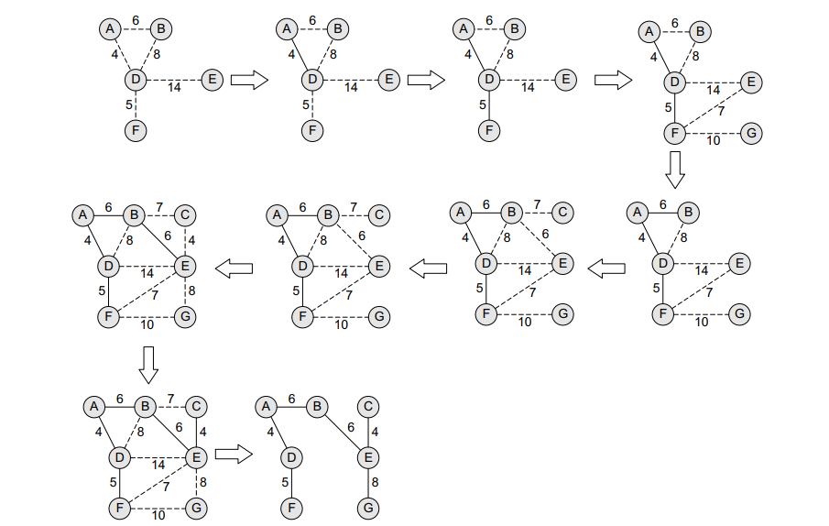
Prims Algorithm

Slide 8
Prims Algorithm (Implementation)
Create a set mstSet that keeps track of vertices already included in MST.
Assign a key value to all vertices in the input graph. Initialize all key values as INFINITE. Assign the key value as 0 for the first vertex so that it is picked first.
While mstSet doesn’t include all vertices
Pick a vertex u which is not there in mstSet and has a minimum key value.
Include u in the mstSet.
Update the key value of all adjacent vertices of u.

Slide 9
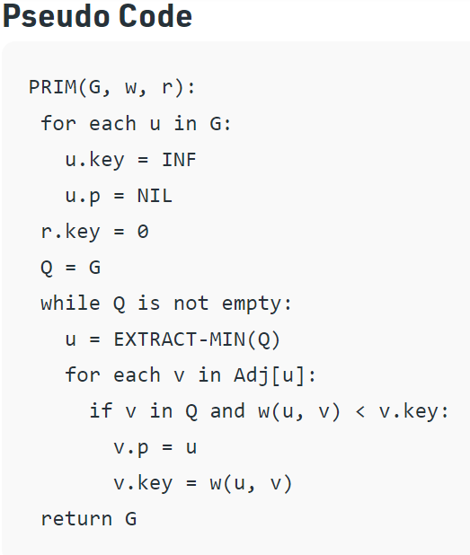
Prims Algorithm (Implementation)

Slide 10
Kruskal’s MST Algorithm
Sort all the edges in non-decreasing order of their weight.
Pick the smallest edge. Check if it forms a cycle with the spanning tree formed so far. If the cycle is not formed, include this edge. Else, discard it.
Repeat step#2 until there are (V-1) edges in the spanning tree.

Slide 11
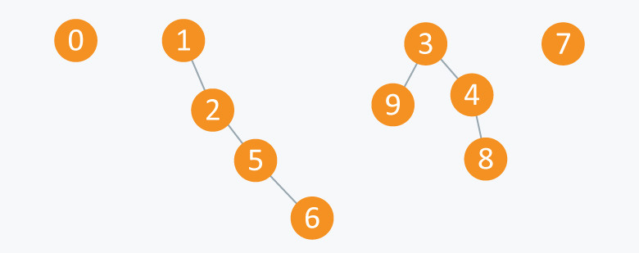
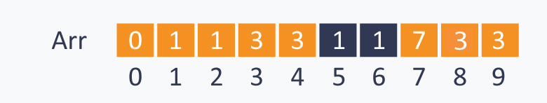
Union-Find
Notes:
Union(2,1), (4,3), (8,4) (9,3) (6,5)
(5,2)

Slide 12
Implementation
void union(int Arr[ ], int N, int A, int B)
{
int TEMP = Arr[ A ];
for(int i = 0; i < N;i++)
{
if(Arr[ i ] == TEMP)
Arr[ i ] = Arr[ B ];
}
}

Slide 13
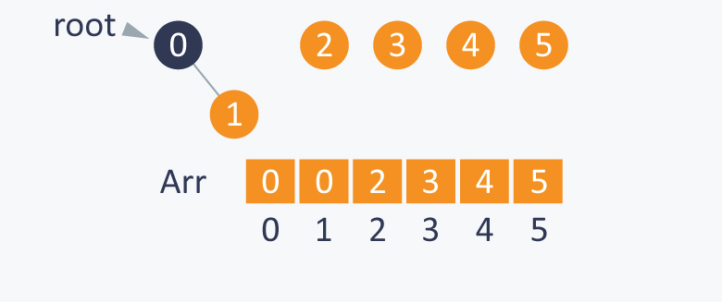
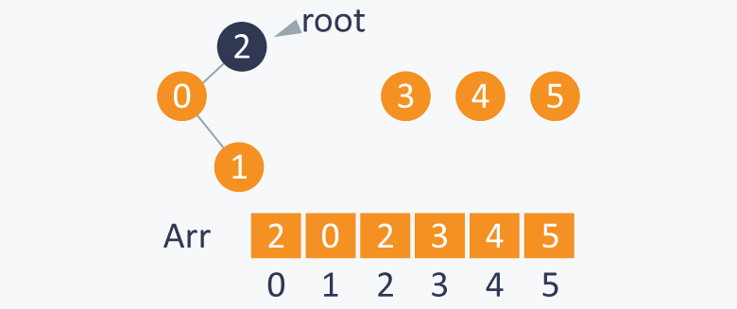
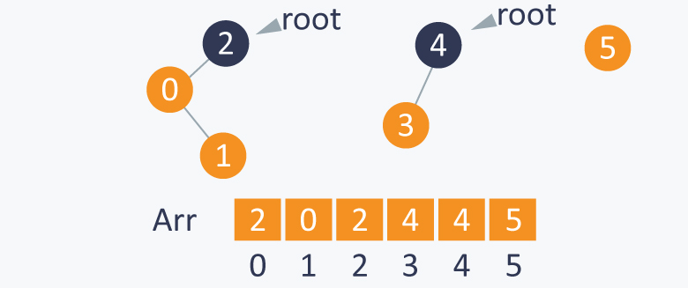
Union-Find
Notes:
(1,0) (0,2) (3,4)
(1,4)

Slide 14
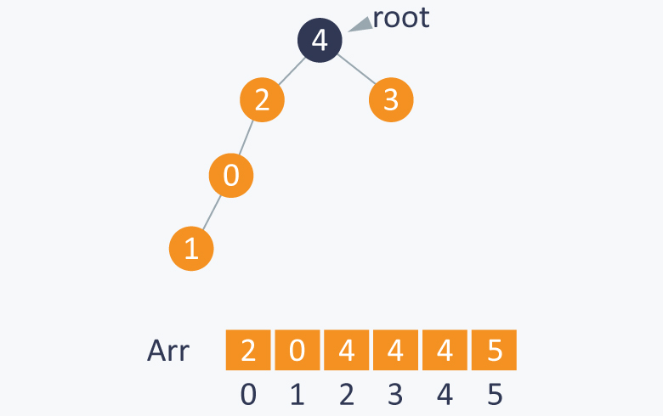
Union-Find
Notes:
(1,0) (0,2) (3,4)
(1,4)

Slide 15
References:
Prim’s Algorithm (Pseudocode):
https://www.geeksforgeeks.org/prims-minimum-spanning-tree-mst-greedy-algo-5/
Union-Find:
https://www.hackerearth.com/practice/notes/disjoint-set-union-union-find/

